Slide 1


Slide 2
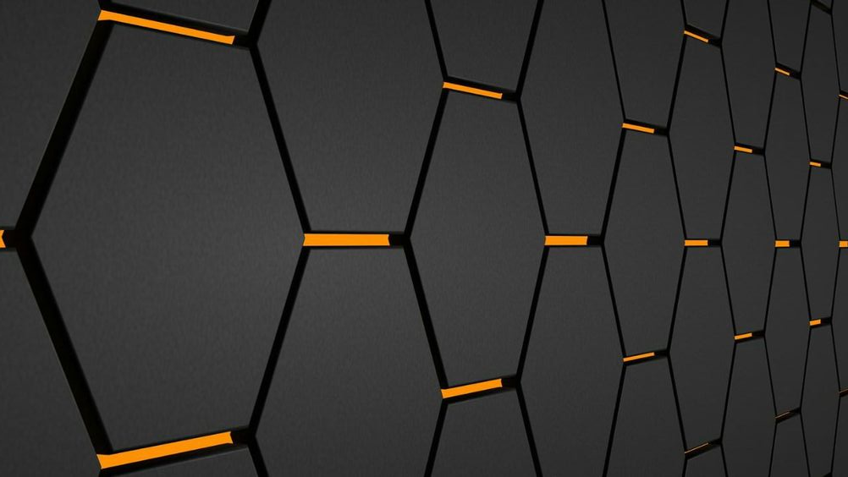
AN OVERVIEW ON
NANOTECHNOLOGY
Conferred by
M.V.Govind

Slide 3
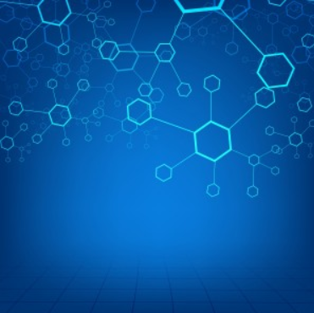
CONTENTS:
Introduction
Developments of nanotechnology
Working of nanotechnology
Applications
Advantages & Disadvantages
Conclusion

Slide 4
INTRODUCTION:
‘Nano’ comes from the Greek word meaning “dwarf” and means one billionth of a meter. Technology is making usage of knowledge of tools, machines and techniques in order to perform a specific function.
K. Eric Drexler has coined the term “NANOTECHNOLOGY” in 1980’s.
It is a part of science and technology that deals with the control of matter on the atomic and molecular scale i. e, about 100nm.
By manipulating the atoms and molecules across the range of physics, chemistry and biology, new products can be fabricated. So, also known as molecular technology.

Slide 5
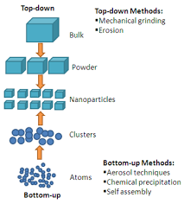
Approaches in nanotechnology:
Bottom up approach
Top down approach.

Slide 6
Developments of nanotechnology:
1) Nanomanipulators: It is a specialized nanorobot and microscopic viewing system for manipulating nanoscopic materials. It consists of optical scanning device, a computer interface. Applications includes carbon nanotubes, polymers, microchips etc.
2) Nanofabrication: It is the design and manufacture of devices in nanoscale. In 1970s, scaling down IC fabrication is used by removing one atom at a time. Next assembly of chip atom-by-atom took place. Later automatic assembling using programmable nanomachines is involved. Finally a biochip might be emerged that might grow like a plant from a seed.
3) Nano-computers: A nano-computer is a computer which is microscopic. Initially single-electron tunneling (SET) transistors in 1985 and single-electron transistors in 1987 are developed. Later interconnection between components took place.
4) Nanorobots: These are also called as nanoboats. One vision of a nanoassembler or nanorobot is a device with robotic arms, motors, sensors and computer to control the behavior, all at the scale of nanometers.

Slide 7
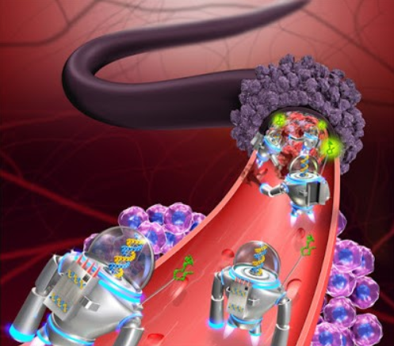
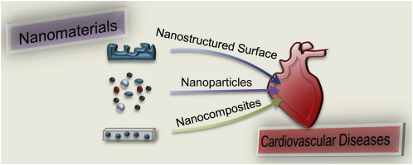
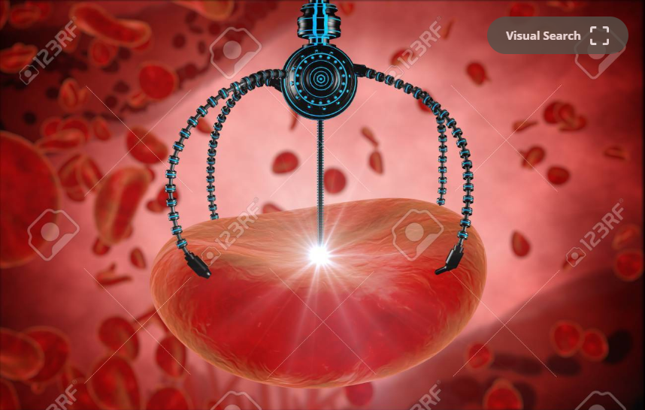
Working:
In medical field, nanotechnology is termed as nanomedicine. It works as the cardiovascular nanomedicine. It cures the heart problems accurately even at the halt stage of functioning of heart. It rectifies the defected valves in the heart. By using nanotechnology, further heart problems which may incur could be predicted.
It is also used to cure cancer cells by involving the nanoparticles to deliver drugs, heat, light to specific type of cells.

Slide 8
Applications:
Nanomedicine: To deliver drugs, heat, light or other substances to specific types of cells such as cancer cells.
Nanoelectronics: To improve display screens on electronic devices and to increase the density of memory chips.
Nanobiotechnology: To clean up existing pollution, improving manufacturing methods to reduce the generation of new pollution.
Cosmetics: It is found in day-to-day life from clothing to skin lotion.
Nano-fabrics: makes fabric water and stain resistant, odor-resistant.
Chemical sensors, carbon nanotubes
Nano devices: nano computers, nanorobots
Neurosurgical practice
Space
Tissue-engineering,

Slide 9
ADVANTAGES:
Products that are stronger, lighter, cheaper, durable and precise can be produced.
Computers that are million times smaller and billion times faster can be developed.
Automatic pollution clean-up.
DISADVANTAGES:
Nanoparticles can cause damage to human body. Carbon nanotubes can cause infection to lungs.
Nano-pollution is created by toxic waste.
Due to mass production in food and consumer products, oil and diamonds becomes worthless.

Slide 10


